Slide 1
Employee Data Analysis using Excel
STUDENT NAME: R.Abinaya
REGISTER NO: 312209398
DEPARTMENT: B.COM( Accounting and Finance)
COLLEGE: Anna Adarsh college for women

Slide 2
PROJECT TITLE
Employee Performance Analysis using Excel

Slide 3


AGENDA
Problem Statement
Project Overview
End Users
Our Solution and Proposition
Dataset Description
Modelling Approach
Results and Discussion
Conclusion
3/21/2024 Annual Review

Slide 4

PROBLEM STATEMENT
A Problem statement is a concise description of an issue that needs to be addressed. It outlines the problems background its impact and the context in which it exists. It typically includes the problems scope, the stakeholders involved, and the desired outcome or solution.

Slide 5

PROJECT OVERVIEW
A Project overview provides a brief summary of a projects objectives, scope, and key deliverables. The database contains various attributes such as employee ID, Name, Department, Job title, work location.

Slide 6

WHO ARE THE END USERS?
HR TEAM
PROJECT MANAGER
SENIOR LEADERSHIP
LEANING AND DEVELOPMENT
TEAM LEAD
DATA ANALYSTS

Slide 7

OUR SOLUTION AND ITS VALUE PROPOSITION
CENTRALIZED DATA
VISUAL INSIGHTS
DATA ANALYSIS
COST EFFECTIVE
TREND ANALYSIS
STABLE FRAMEWORK

Slide 8
Dataset Description
Employee ID
Name
Gender
Department
Salary
FTE
Employee type
Start date
Work location

Slide 9

THE "WOW" IN OUR SOLUTION
DATA ACCURACY
CUSTOMIZABLE VIEWS
PREDICTIVE ANALYSIS
REPORTERS AND NOTIFICATIONS
ANALYTICS
INSIGHTS
3/21/2024 Annual Review
9

Slide 10
MODELLING
Conditional formatting
Data bars
Icon set
Pivot tables
Line chart
10

Slide 11
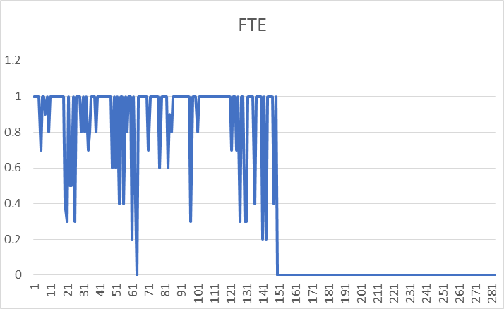
RESULTS
11

Slide 12
conclusion
Analyzing employee performance using Excel can be quite effective if approached systematically. Here's a concise conclusion about it :Excel provides a platform for tracking and analyzing employee performance through various tools like charts, pivot tables, and conditional formatting. By systematically inputting performance data, setting clear metrics, and utilizing Excel’s analytical functions, organizations can gain insights into individual and team performance. This can help in identifying strengths and areas for improvement, setting goals, and making data-driven decisions for employee development and management. However, it is important to ensure data accuracy and consider the limitations of Excel in handling very large datasets or complex analyses, where more specialized software might be needed.

